Slide 1
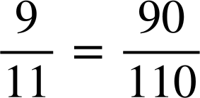
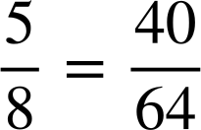
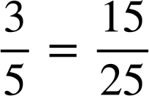
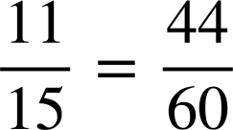
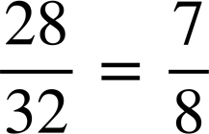
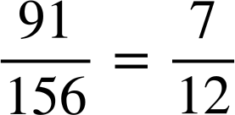
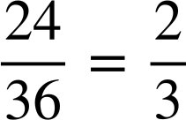
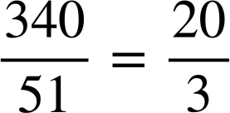
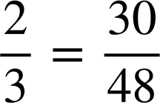
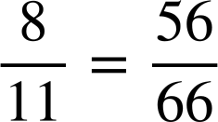
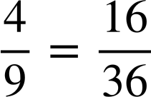
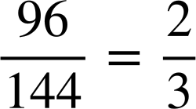
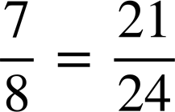
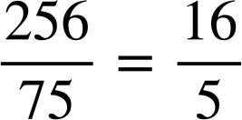
Ordering fractions by way of a common denominator
Task A: Review writing equivalent fractions
1) Fill in the missing numerator or denominator.
a)
e)
b)
f)
c)
g)
d)
h)
2) Which of the following are true?
a)
b)
c)
× 15
× 16
False
d)
e)
f)
× 7
× 6
False
× 4
× 4
True
÷ 48
÷ 48
True
× 3
× 3
True
÷ 16
÷ 15
False

Slide 2
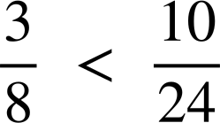
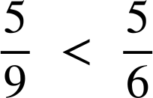
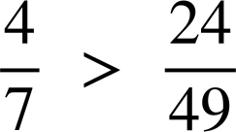
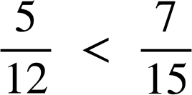


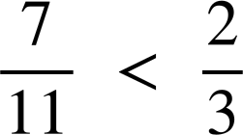
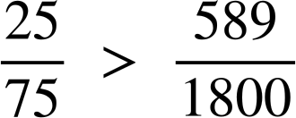




Ordering fractions by way of a common denominator
Task B: Comparing fractions
1) Use equivalent fractions to decide which fraction is greater.
Insert either < or > to make the statement true.
a)
e)
b)
f)
c)
g)
d)
h)
2)
Place the words ‘greater’ and ‘less’ in the sentence:
is less than but greater than
Jacob says “ is exactly halfway between and .”
Is he correct?
Jacob is correct as there is between and , as well as between and .

Slide 3








Ordering fractions by way of a common denominator
Task C: Order fractions using equivalent fractions
Write the following fractions with a common denominator and order from smallest to largest.
a)
b)
c)
d)
Mathematics in Education and Industry
v2.2

